Slide 1



LARAC Executive meeting 20th May 2021
Dr David Greenfield -SOENECS MD And
Natalie Ibbott – SOENECS SENIOR Researcher

Slide 2
Research
SOENECS undertook the following activities over a 6 week period:
created and circulated a 104 questions questionnaire,
undertook a review of all 311 local authority garden waste web pages and
cleaned, summarised and modelled the resultant data to create the findings in this report.
We then created of a final report with 7 case studies

Slide 3
Responses to the Questionnaire
Region | Number of Local Authority responses
East | 18
East Midlands | 14
London | 7
North East | 5
North West | 15
South East | 36
South West | 9
West Midlands | 13
Yorkshire and The Humber | 11
Grand Total | 128

Slide 4
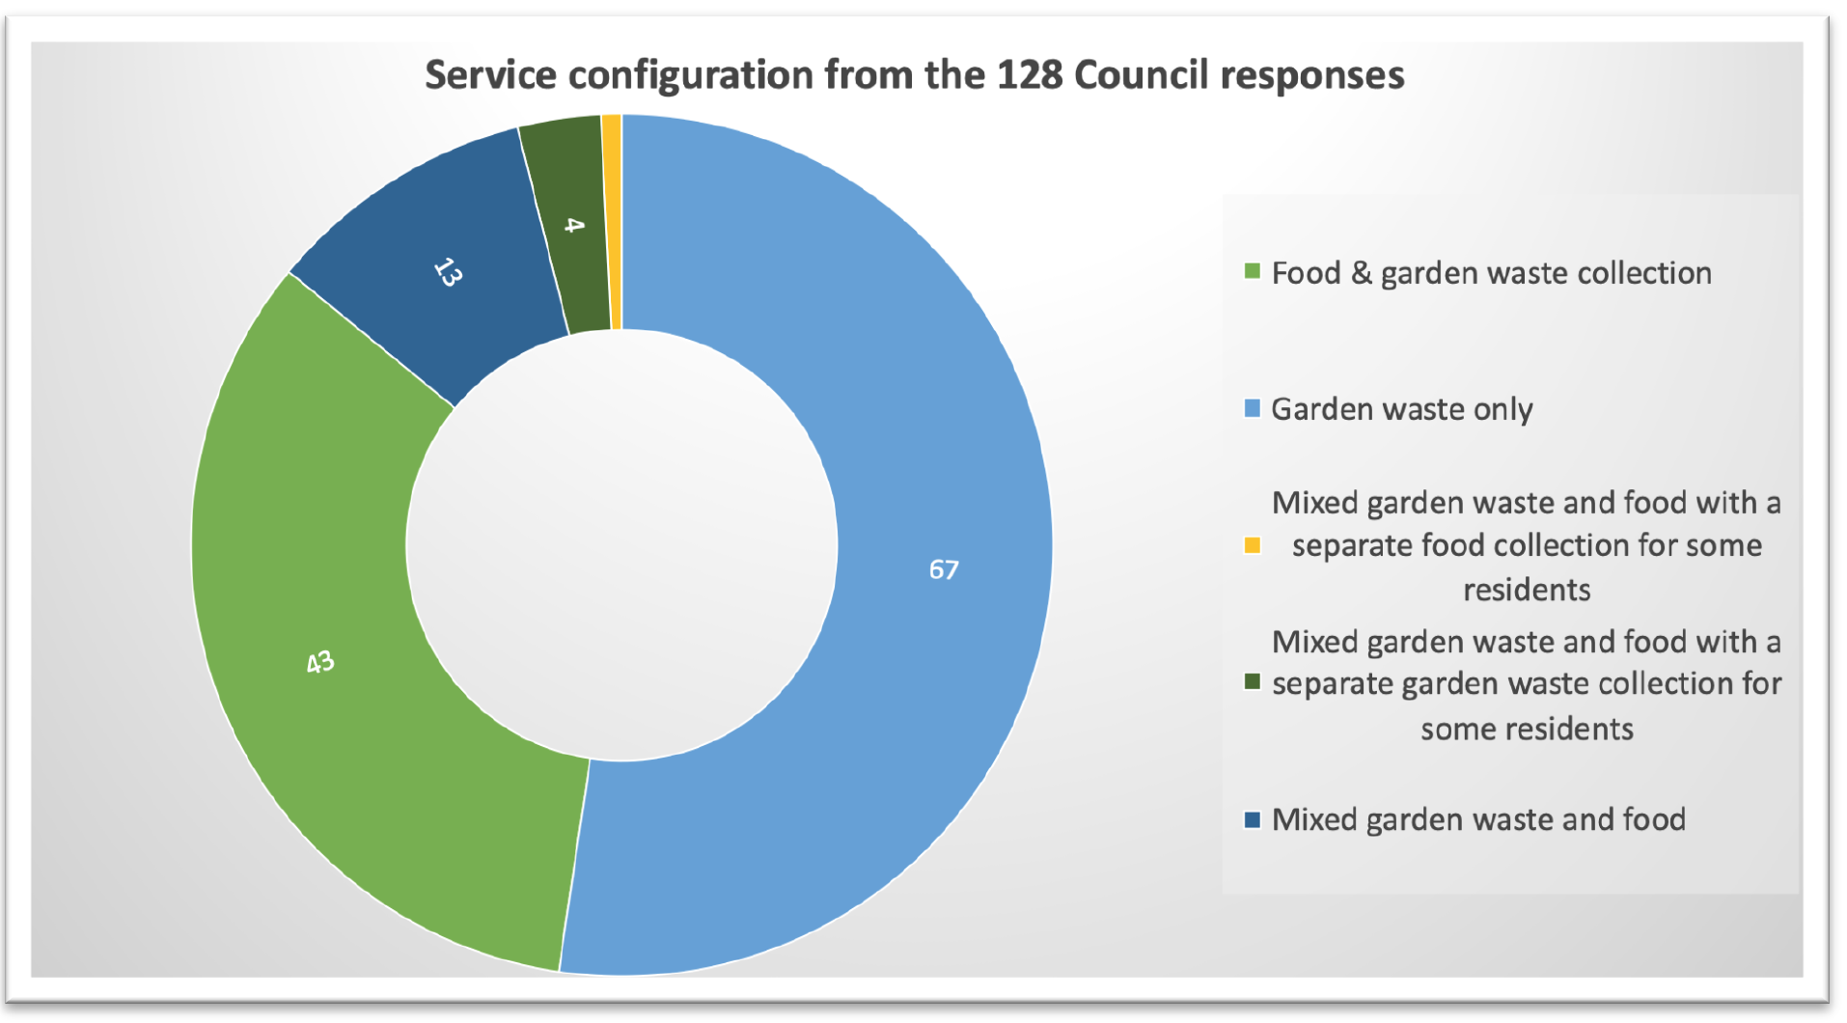


Slide 5
Number of households offered a Green Waste service

Slide 6
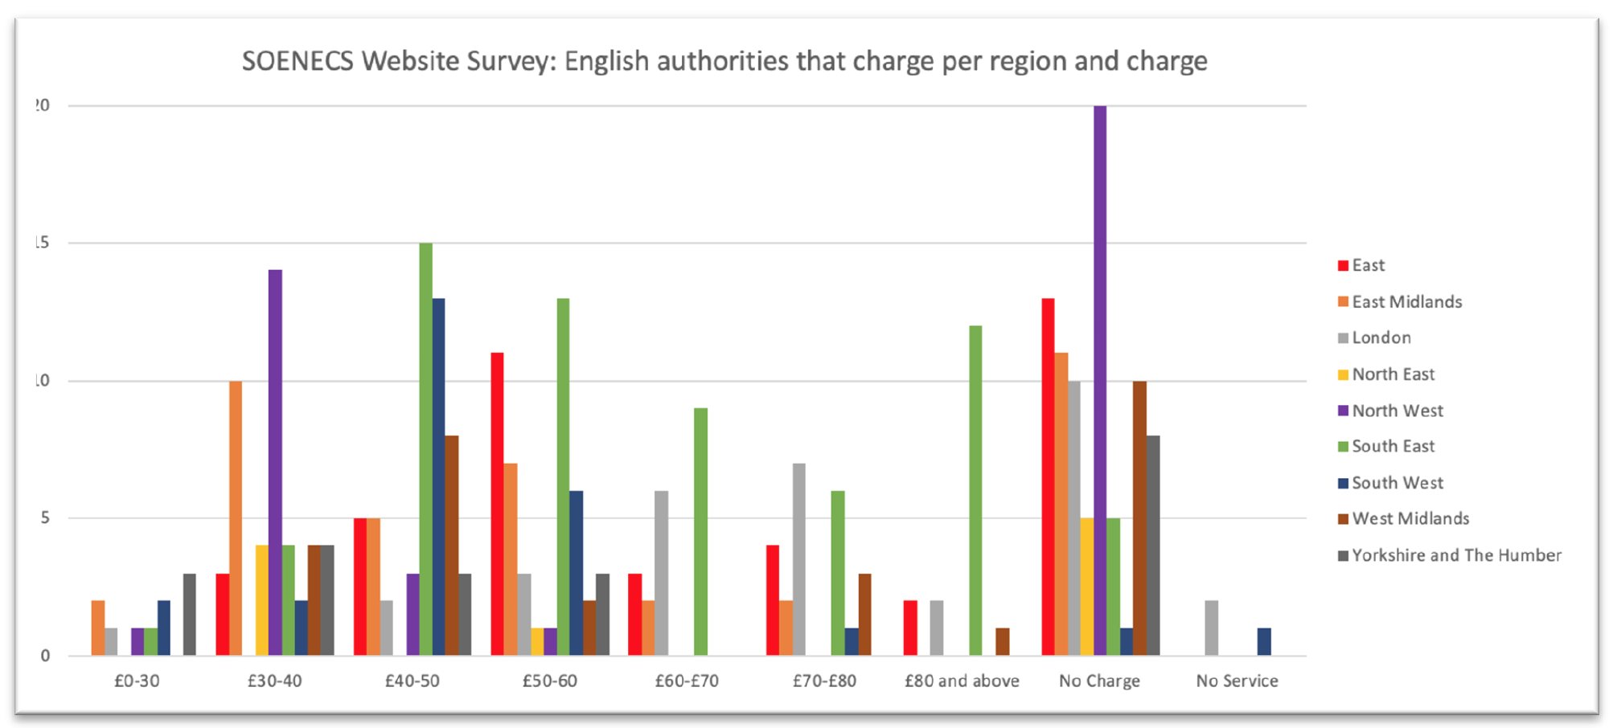
Annual cost of bins

Slide 7
Previous charging regime

Slide 8
Contractor and service mix
Service Type | Free | Paid for | Unknown | Grand Total
DSO / in house | 24 | 38 |  | 62
FD & GW | 5 | 11 |  | 16
GW Only | 12 | 26 |  | 38
M GW & FD & FD | 1 |  |  | 1
M GW & FD & GW | 1 | 1 |  | 2
M GW & FD ONLY | 5 |  |  | 5
Waste Management Company | 14 | 45 |  | 59
FD & GW | 2 | 24 |  | 26
GW Only | 4 | 20 |  | 24
M GW & FD & GW | 1 | 1 |  | 2
M GW & FD ONLY | 7 |  |  | 7
Unknown | 1 | 4 | 2 | 7
FD & GW |  | 1 |  | 1
GW Only | 1 | 3 | 1 | 5
M GW & FD ONLY |  |  | 1 | 1
Grand Total | 39 | 87 | 2 | 128

Slide 9
Vehicle and driver mix
 | Driver + 1 | Driver + 2 | Driver + 3 | Driver + 4 | Unknown | Total
FD & GW | 15 | 23 | 1 | 1 | 2 | 42
Caged Vehicle | 1 |  |  |  |  | 1
Dedicated RCV | 13 | 23 |  |  | 1 | 37
split Body RCV | 1 |  | 1 | 1 |  | 3
Unknown |  |  |  |  | 1 | 1
GW Only | 8 | 58 |  |  |  | 66
Dedicated RCV | 7 | 57 |  |  |  | 64
split Body RCV | 1 | 1 |  |  |  | 2
M GW & FD & FD |  | 1 |  |  |  | 1
Dedicated RCV |  | 1 |  |  |  | 1
M GW & FD & GW |  | 3 |  |  |  | 3
Dedicated RCV |  | 3 |  |  |  | 3
M GW & FD ONLY |  | 12 |  |  |  | 12
Dedicated RCV |  | 12 |  |  |  | 12
Grand Total | 23 | 97 | 1 | 1 | 2 | 124

Slide 10
Containers

Slide 11
Winter suspension

Slide 12
Website review of charges

Slide 13
Weight and Charging (pt. 1)

Slide 14
Weight and Charging (pt. 2)

Slide 15
Yield

Slide 16
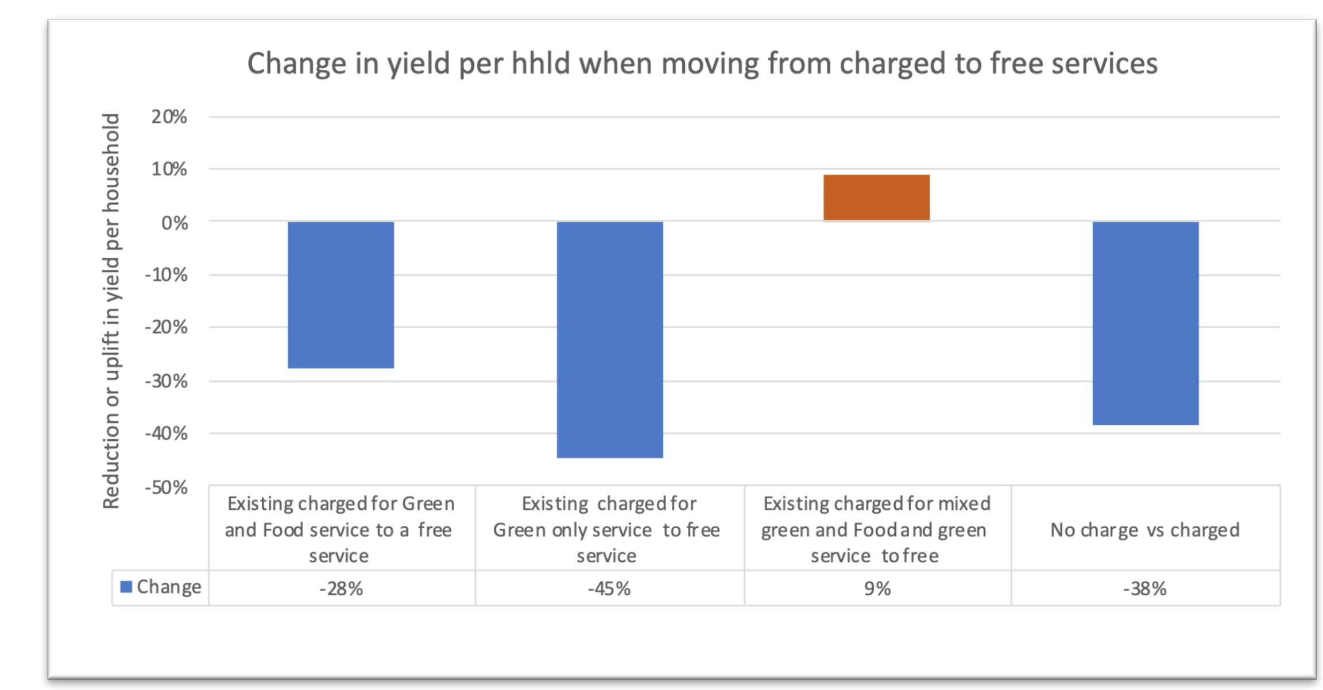
Change in yield by service type

Slide 17
What if all LA’s offered A free GW service?
Modelling does not include costs of new equipment and crew, disposal costs or communications

Slide 18
What if all services were charged for?
Modelling does not include costs of new equipment and crew, disposal costs or communications

Slide 19
Comments
If all authorities across England move from their existing services and offer a free collection service, based upon the modelled good performance of 71% coverage, and collect 197kg/household, then an extra 2.06 million tonnes of garden waste (excluding food) could be collected.
This would result in a possible loss of a possible £629 million in income to local authorities from households.
This loss of income does not include the extra capital, additional disposal costs, new equipment and crew and communications required to move from an average of 50% coverage to 71% coverage.
Our modelling suggests that if there was 40% coverage and a yield of 285kg/household for those that charge and for free services a coverage of 71% and a yield of 197 kg/household, authorities would collect 6.38m tonnes of garden waste for recycling

Slide 20

Thank you for your Time
Dr David Greenfield
e-mail: davidg@soenecs.co.uk
david@circulareconomyclub.com
web: www.soenecs.co.uk
www.circulareconomyclub.com

